Slide 1
Aligning datasets with shared observations but different features

Slide 2
The dataset
1047 observations for which either scRNA-seq data or ATAC-seq data is recorded
12407 shared features

Slide 3
Experimental design
2 controls: one without standard preprocessing steps, one with preprocessing
Controls are evaluated without alignment using visualization (PCA, t-SNE, UMAP) and quantitative measures (ARI and ASW)
For each visualization, a subset of observations are plotted with lines connecting identical observations – this gives us an idea of how far the observations are from each other in space
Using Harmony, UnionCom, and MMD-ResNet, the dataset is aligned and evaluated using the same techniques

Slide 4
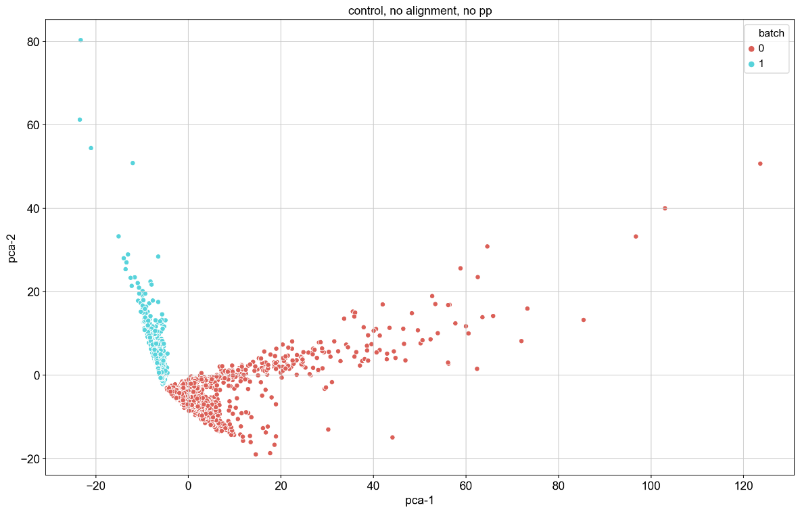
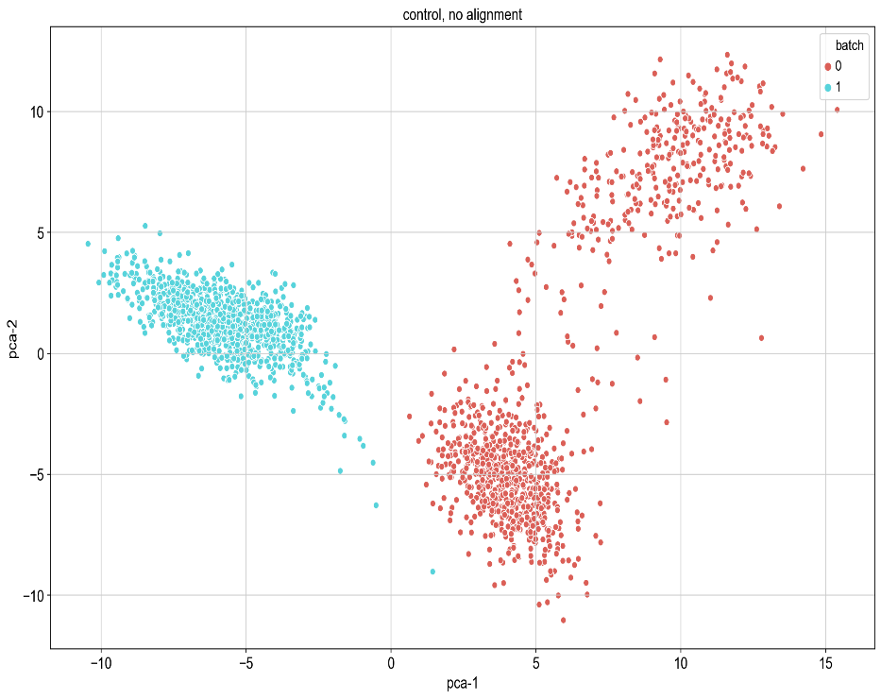
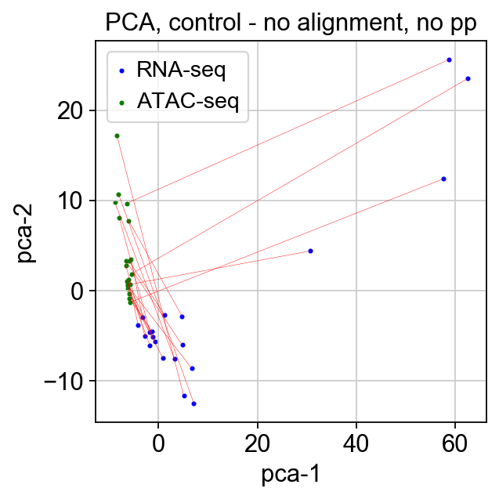
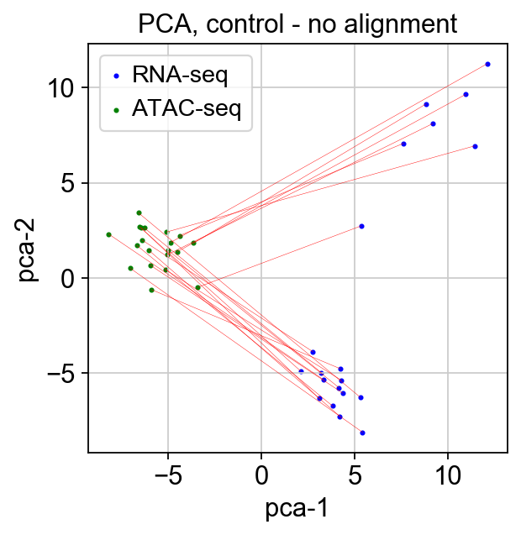
Controls - PCA

Slide 5
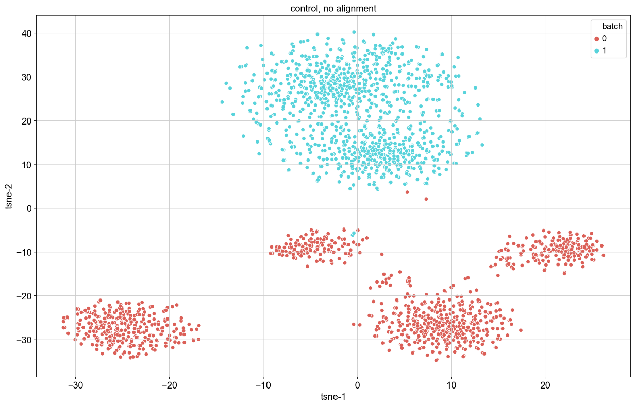
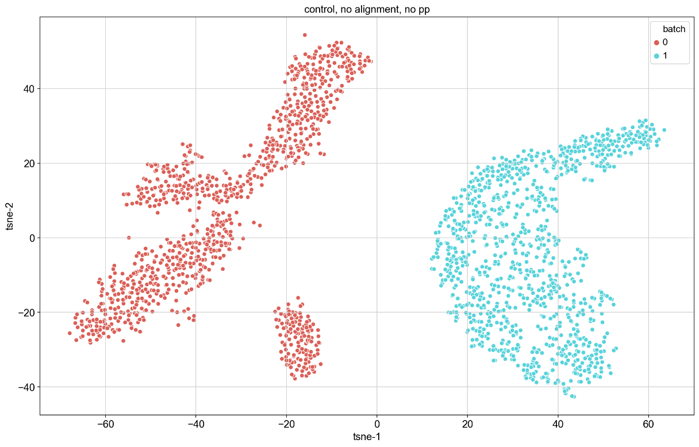
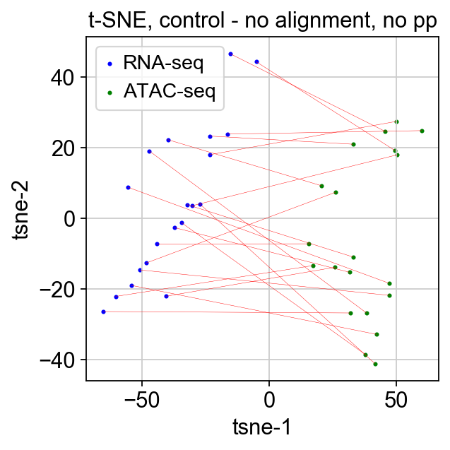
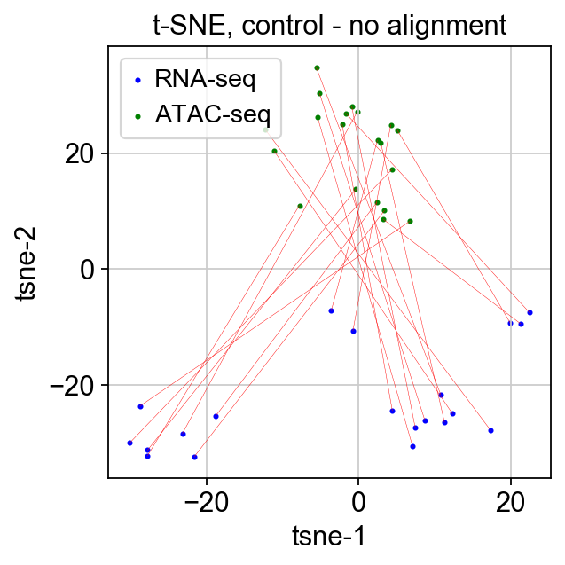
Controls – t-SNE

Slide 6
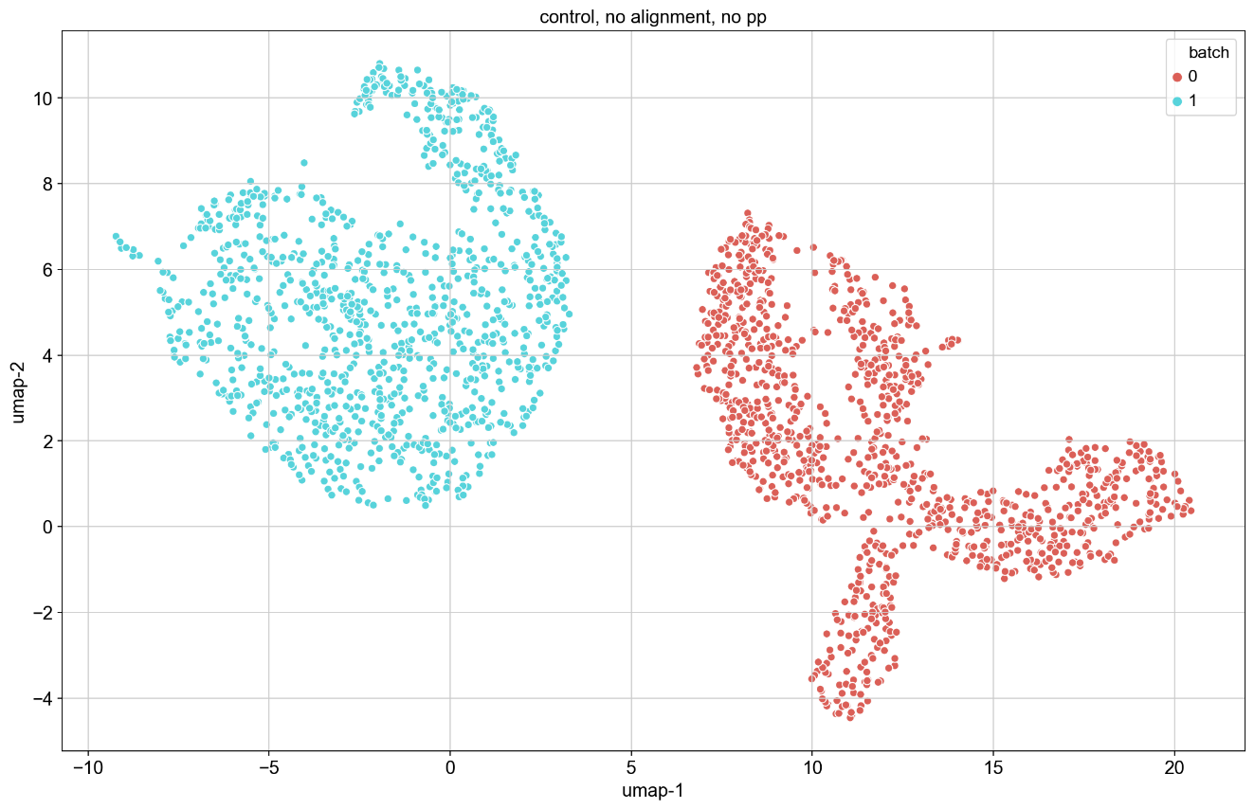
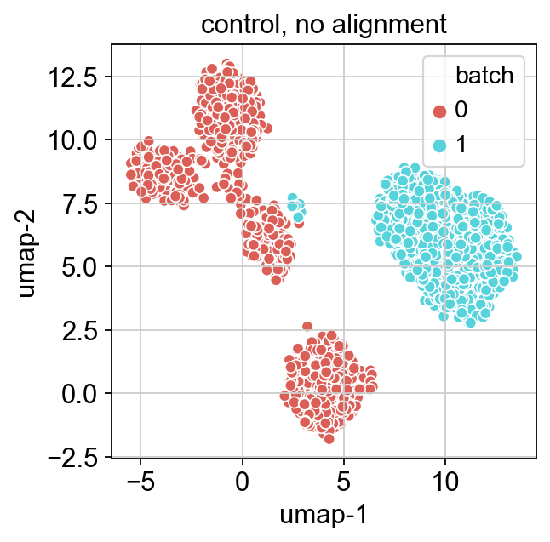
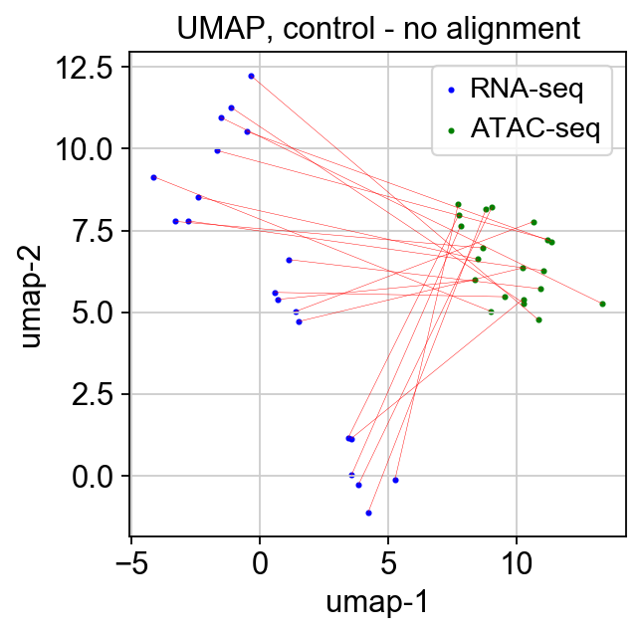
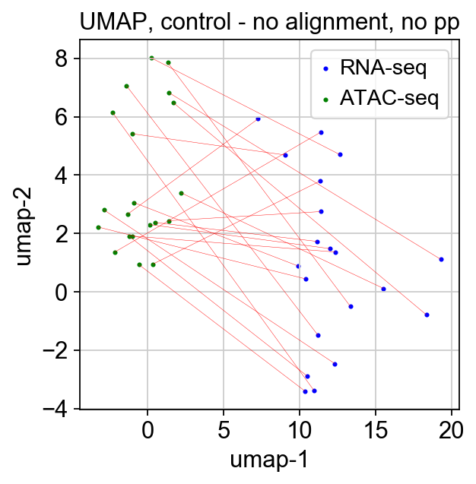
Controls – UMAP

Slide 7
Controls – ARI and ASW
Preprocessed – ASW = .014, ARI = .475
No processing – ASW = .0617, ARI = 1

Slide 8
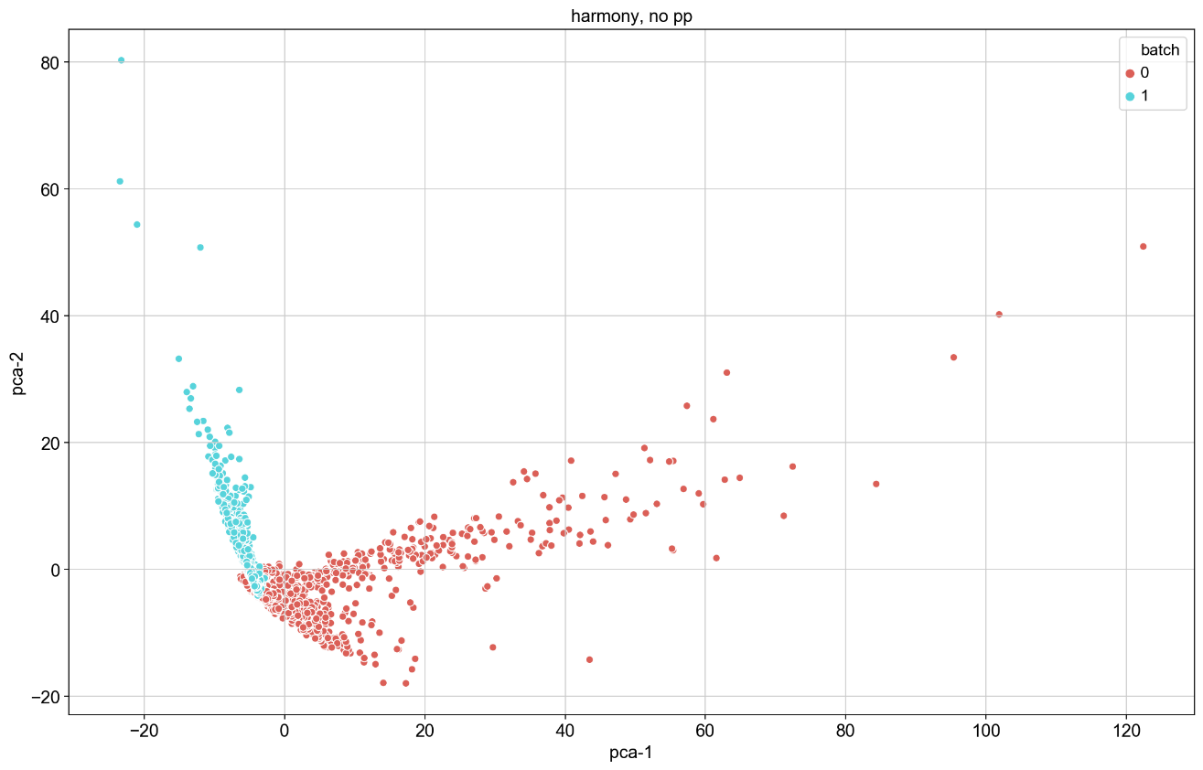
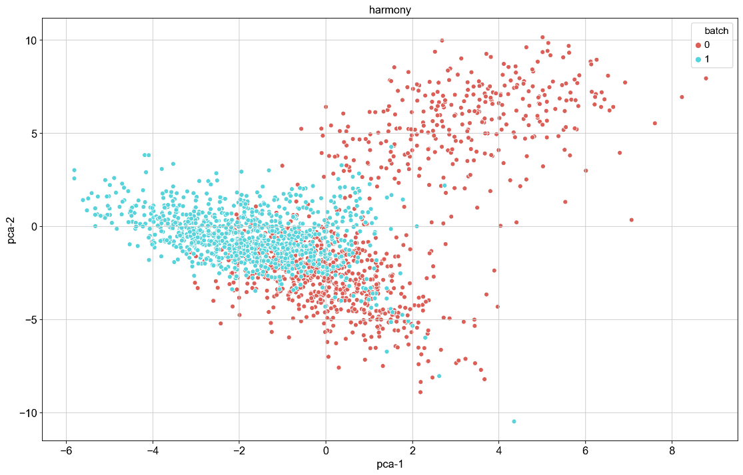
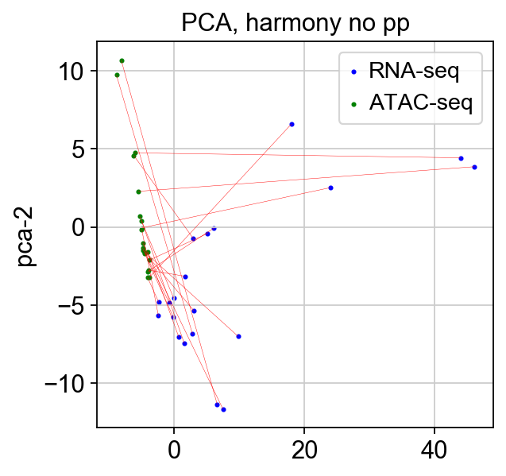
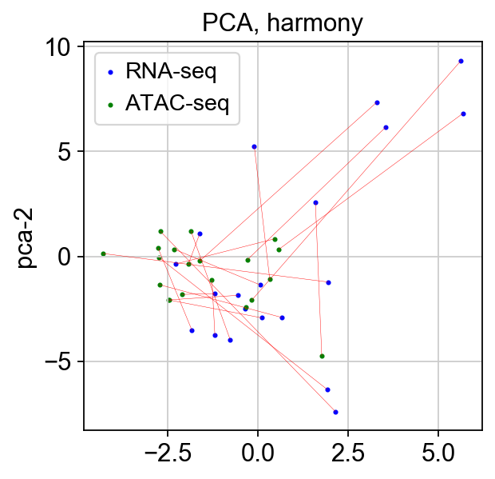
Harmony - PCA

Slide 9
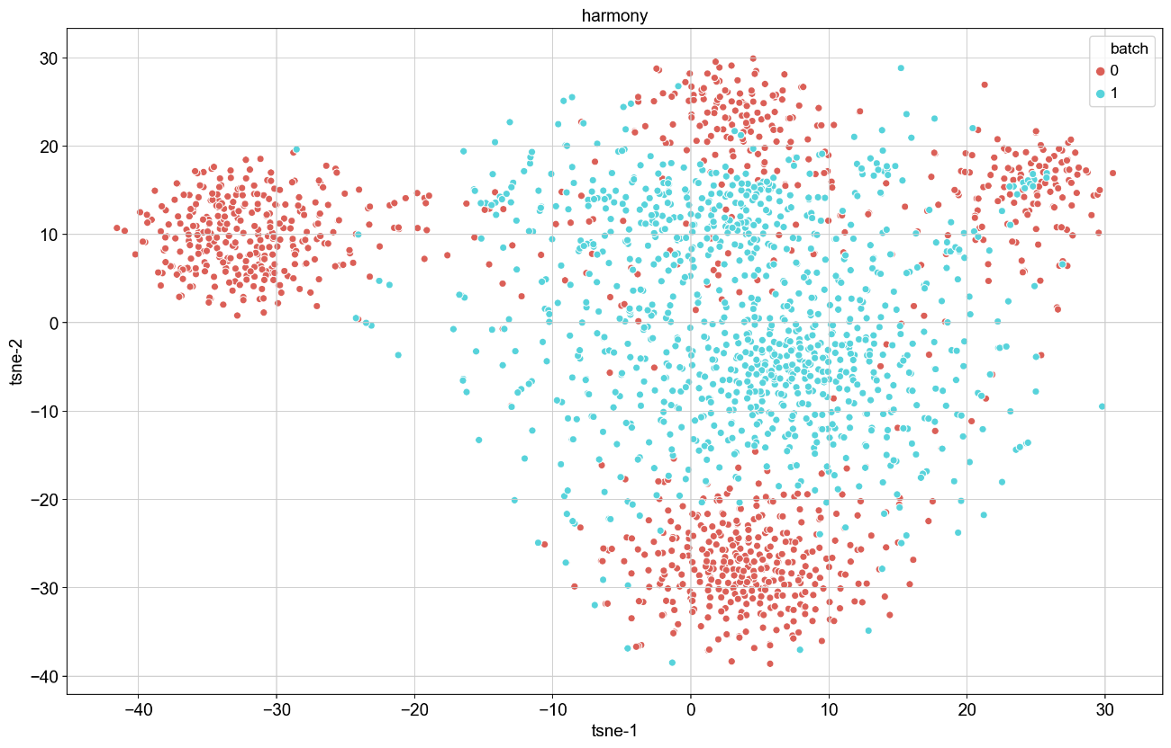
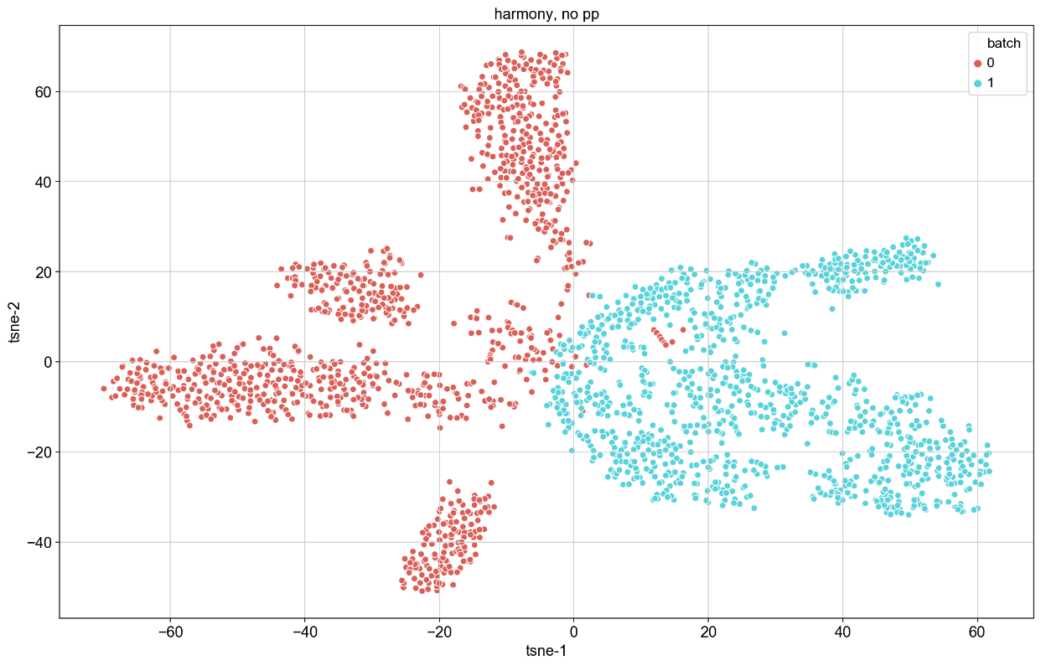
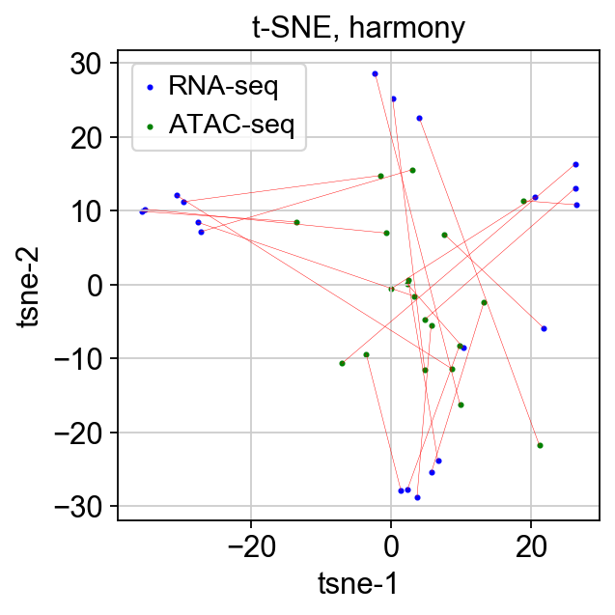
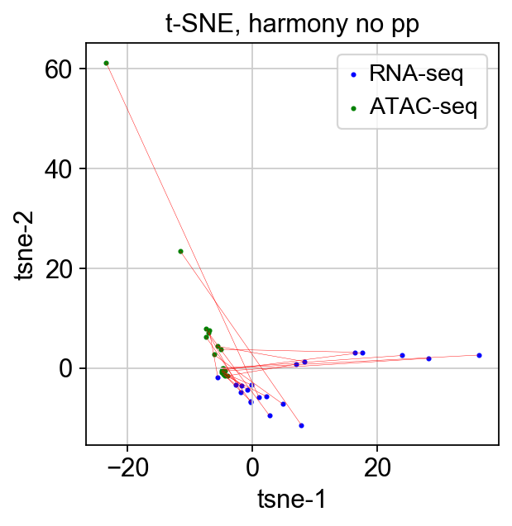
Harmony – t-SNE

Slide 10

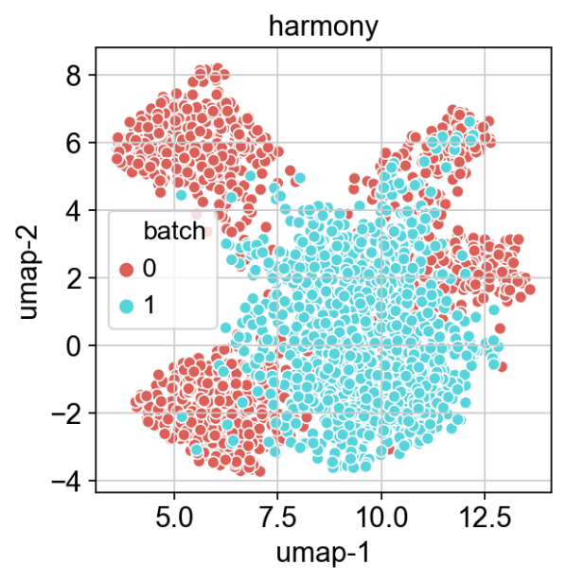
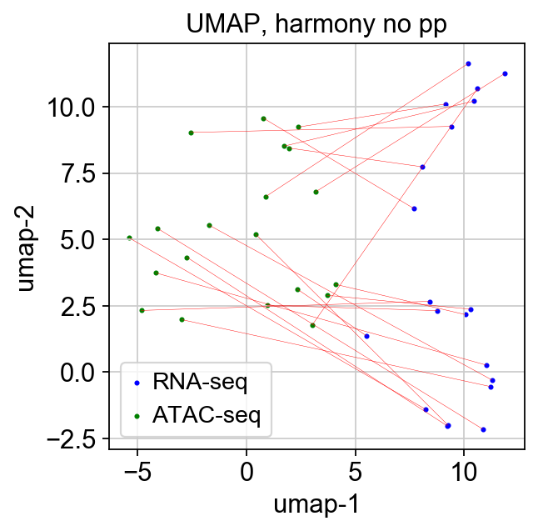
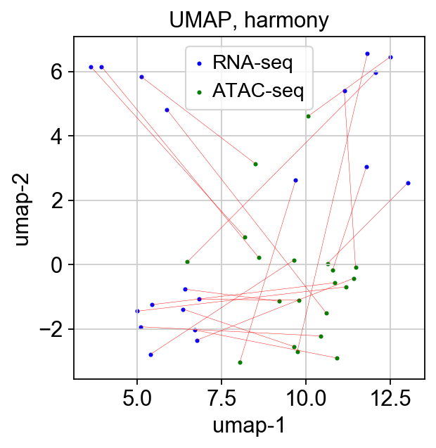
Harmony - UMAP

Slide 11
Harmony – ASW and ARI
ASW-pp = .1699, ARI-pp = .088
ASW-npp = .163, ARI-npp = .02067

Slide 12
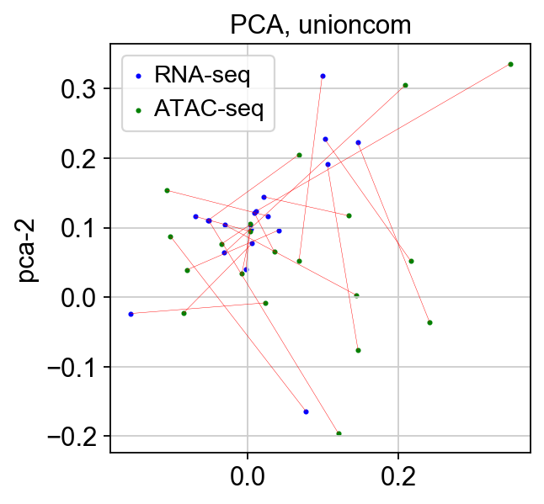
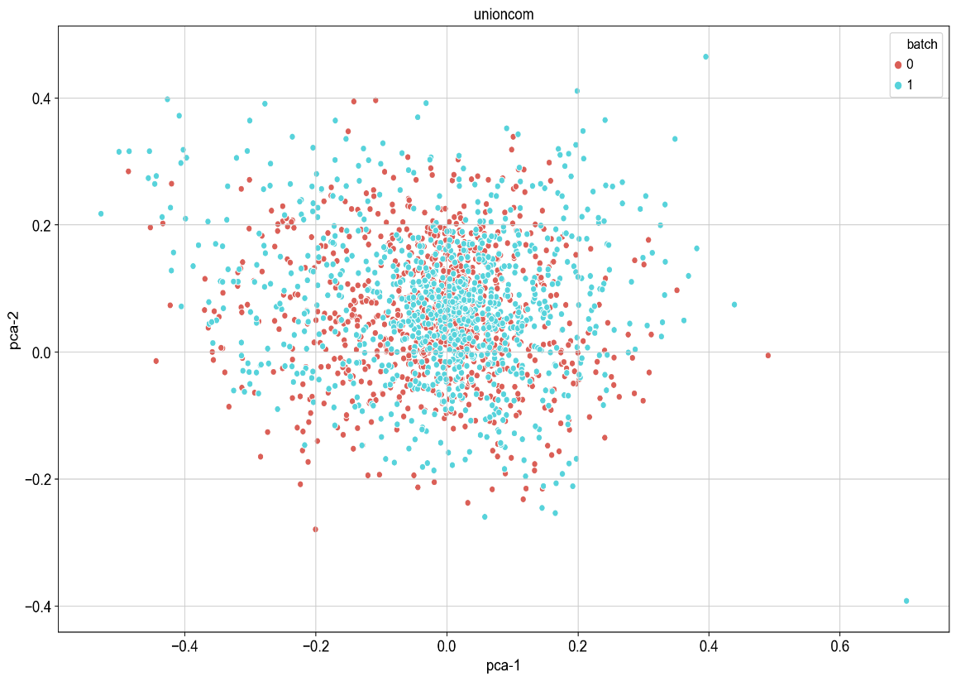
UnionCom - PCA

Slide 13
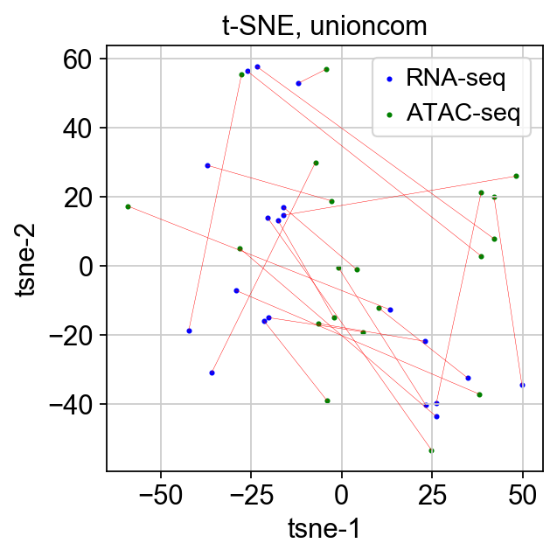
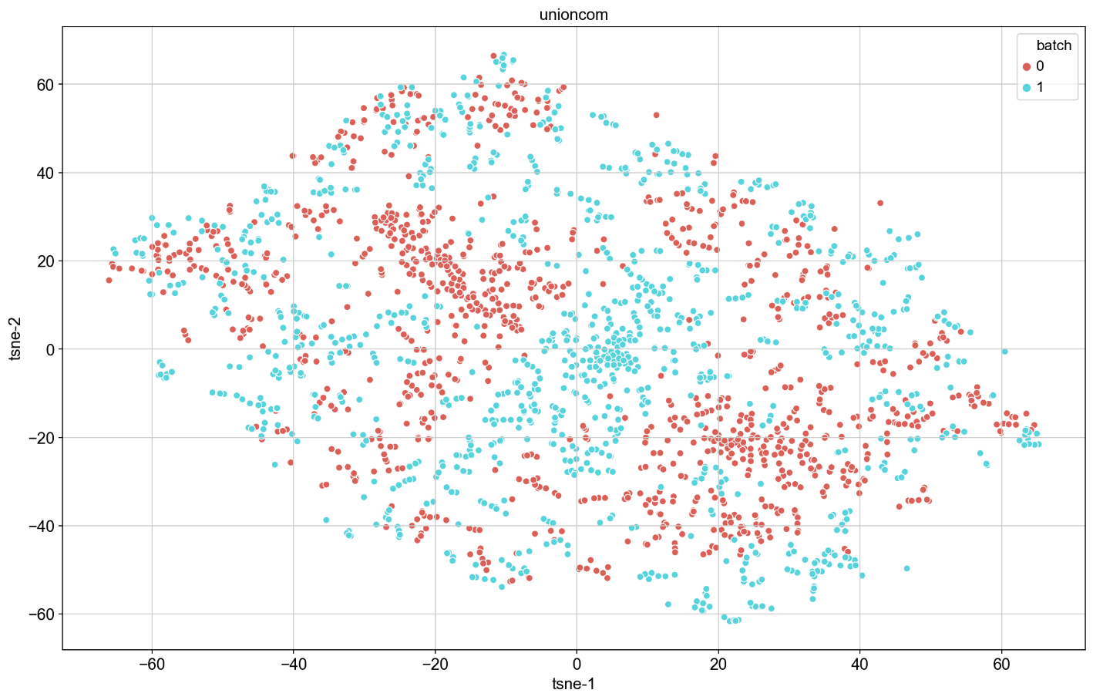
UnionCom – t-SNE

Slide 14
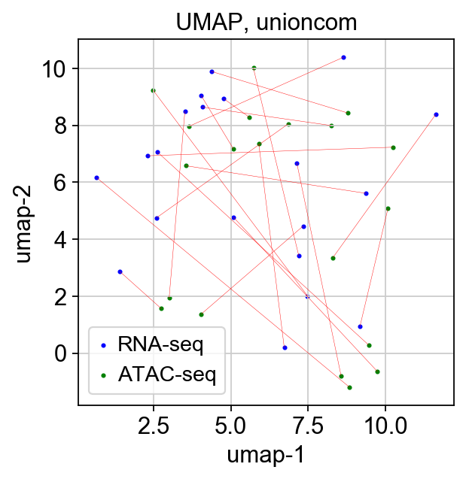
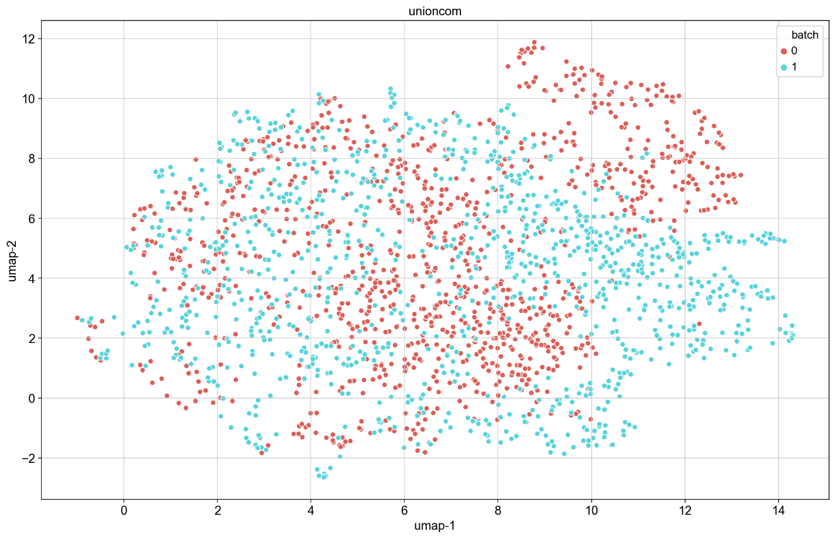
UnionCom - UMAP

Slide 15
UnionCom – ASW and ARI
ASW = .004596
ARI = .000163

Slide 16
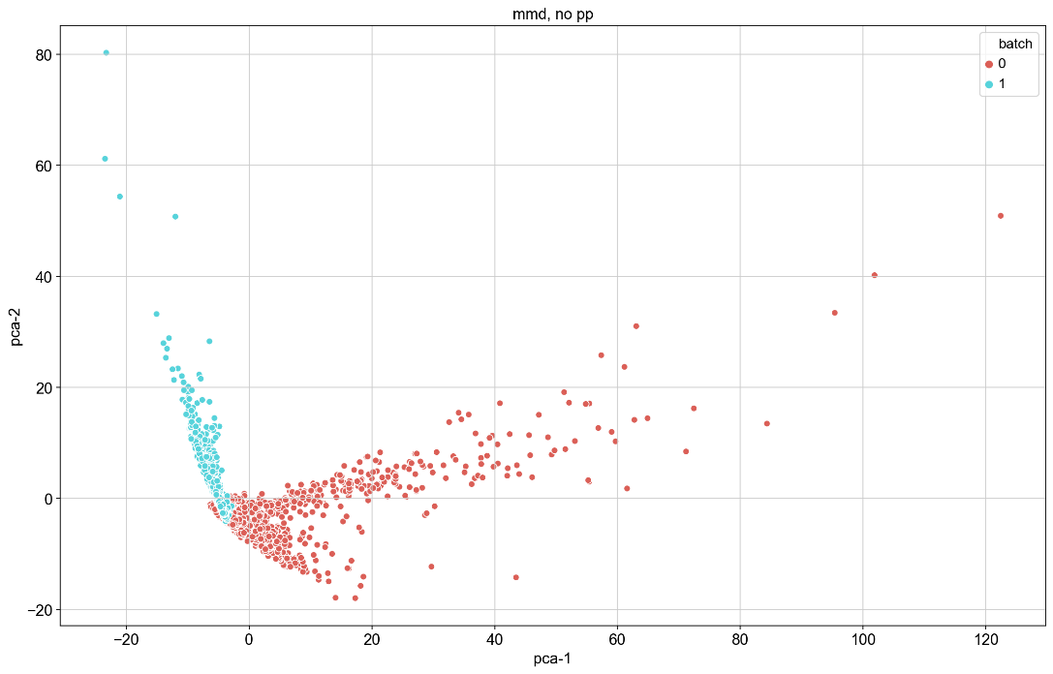
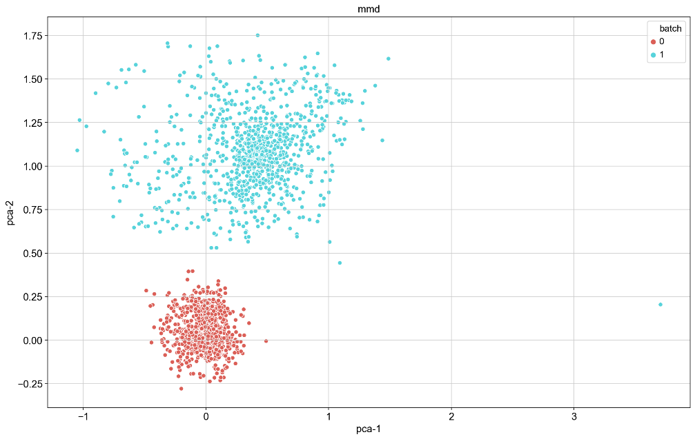
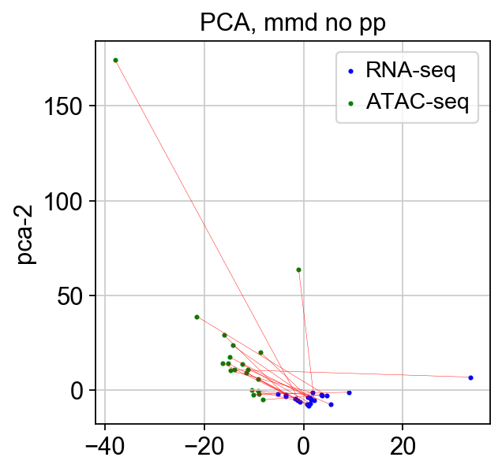
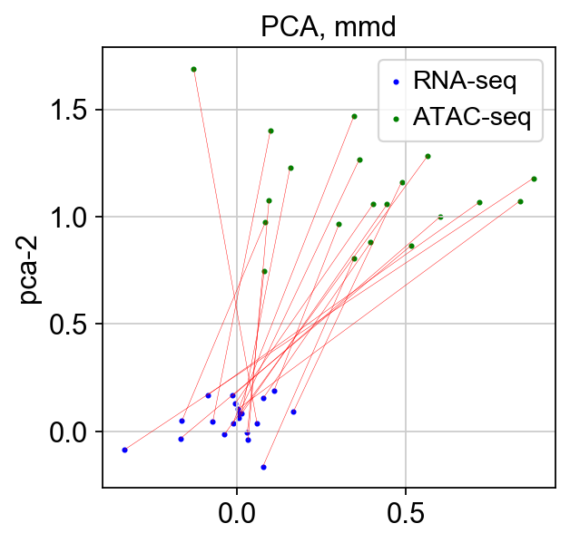
MMD-ResNet - PCA

Slide 17
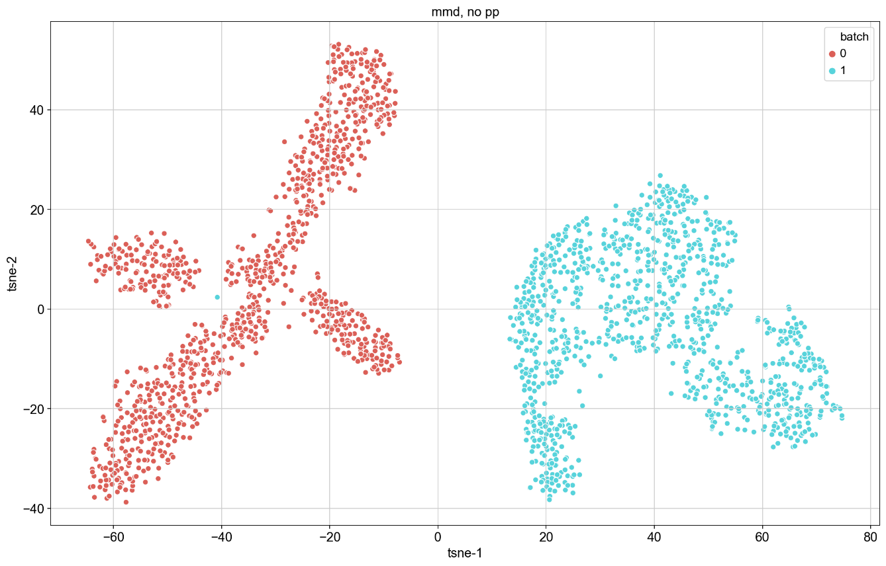
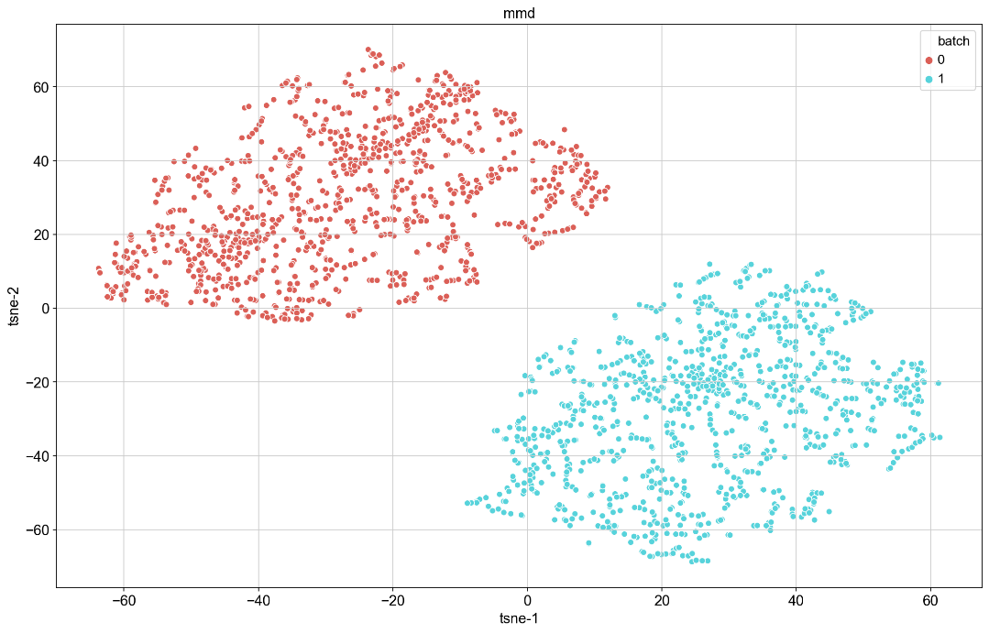
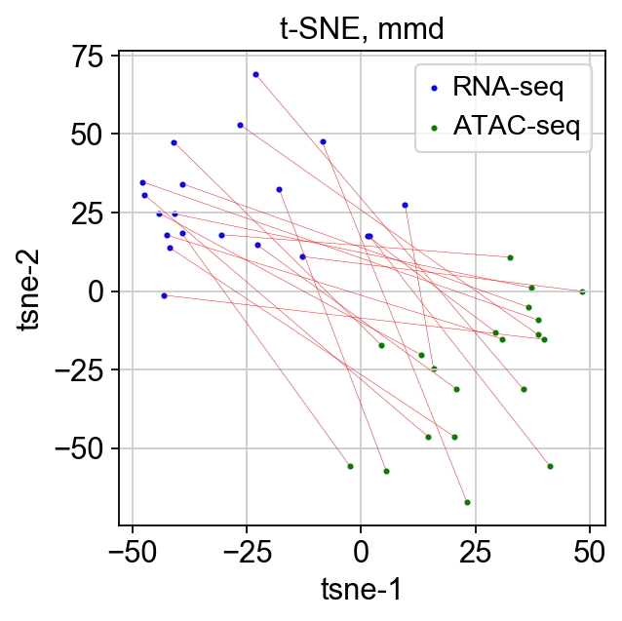
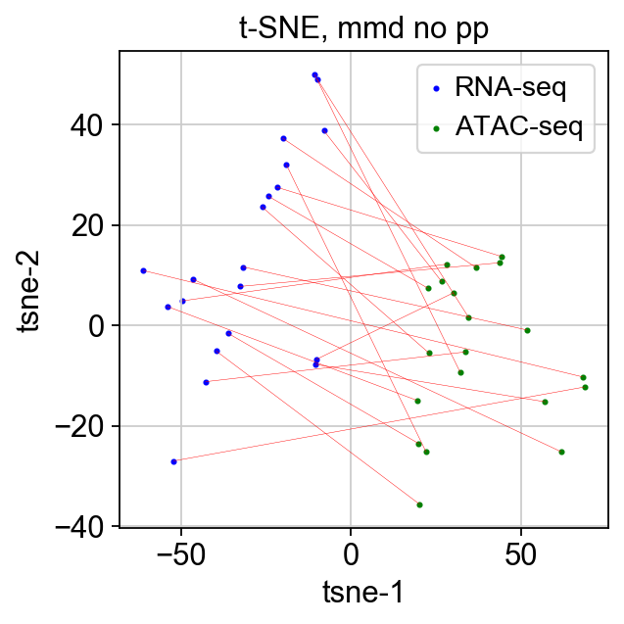
MMD-ResNet –t-SNE

Slide 18
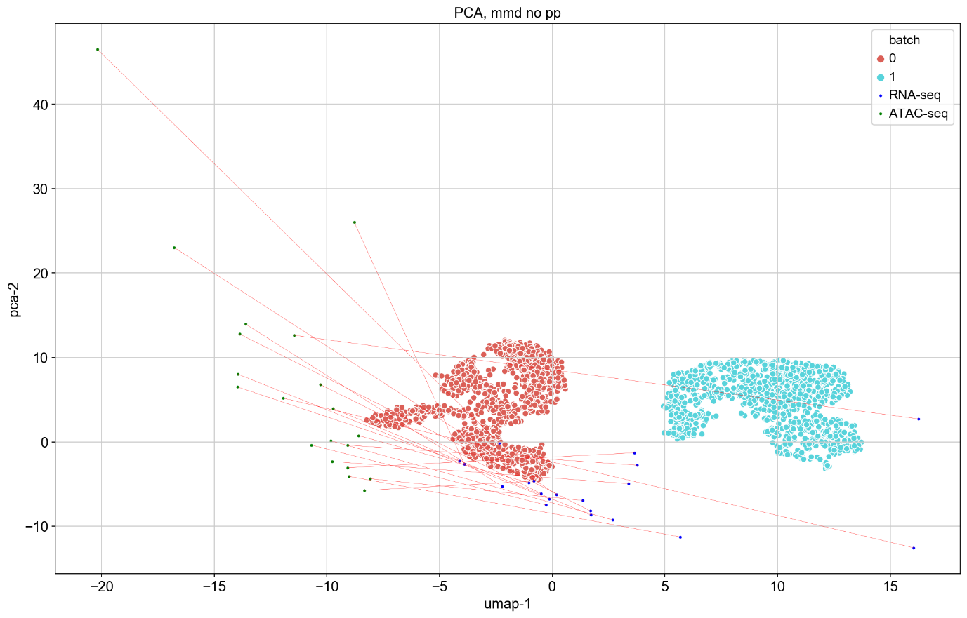
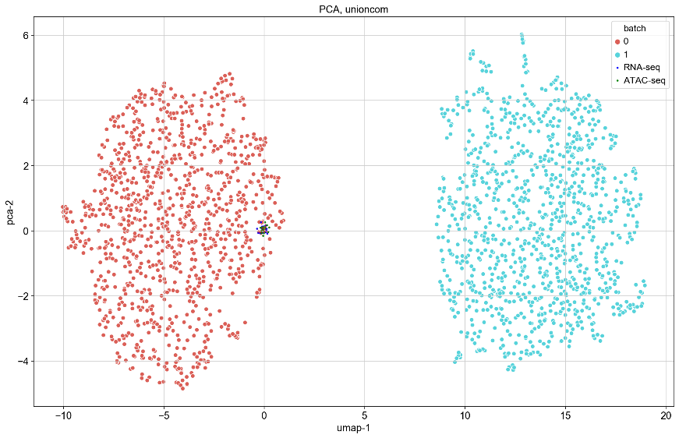
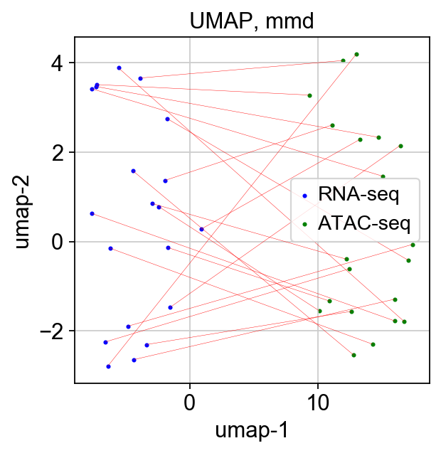
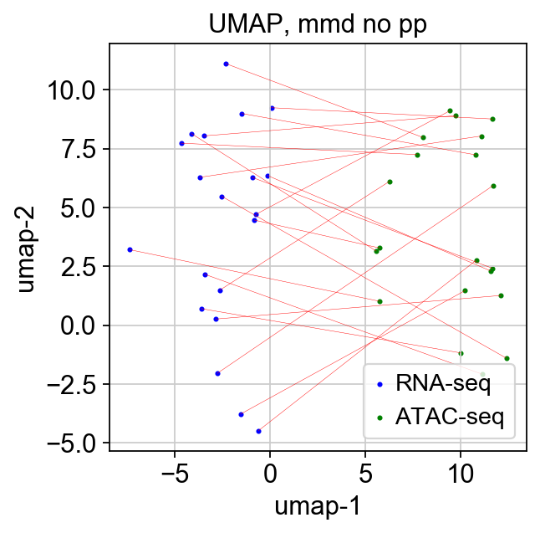
MMD-ResNet - UMAP

Slide 19
MMD-ResNet – ARI and ASW
ASW-pp = .647, ARI-pp = .00016
ASW-npp = .194, ARI-npp = .086

